Slide 1
context Aware High-Fidelity rendering over Peer-to-peer systems
Adrian De Barro
University of Malta

Slide 2
Overview:
Introduction
Irradiance Cache
Collaborative Environments
State of the Art in Peer-to-Peer Rendering
The Over-Saturation problem
Two Phase Irradiance Cache (2PIC)
Context Aware P2P Rendering (CAP2P)
Limitations & Future Work
Conclusion
Impact

Slide 3
Introduction
High-fidelity rendering (HFR) is the process of creating synthetic images indistinguishable from real world photos
HFR simulates light transport through the use of global illumination (GI) algorithms
GI is modelled through the use of the rendering equation
Direct lighting accounts for all the light sources contributing to a point
Indirect lighting accounts for all the surrounding surfaces that reflect light onto a point

Slide 4
Light Energy Reflected by a Point
$${Light}_{output}=Emitted + {Reflected}_{direct }+ {Reflected}_{indirect}$$
Light emitted
by other sources
of light
Light reflected off other surfaces onto
the point
Light emitted
by a surface

Slide 5
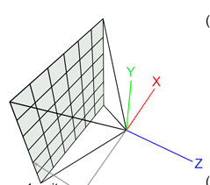



Direct Lighting Component
Shadow ray
Direct Lighting
Computation
Ray cast from camera
View plane

Slide 6
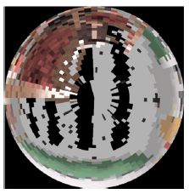
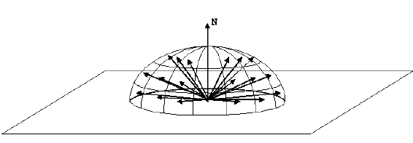
Indirect Lighting Component
Indirect Lighting
Computation
Ray cast from camera
View plane

Slide 7
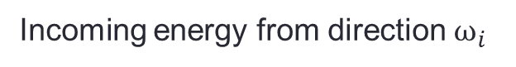
Rendering Equation
$${Light}_{output}=Light_{emitted} + {Reflected}_{direct}+{Reflected}_{indirect}$$
Foreshortening term
Reflectance
function
Incoming energy from direction $ω_{i}$
$L_{o}\left(x,ω_{o}\right)=L_{e}\left(x,ω_{o}\right)+ \int_{Ω}{f\left(x,ω_{o},ω_{i}\right)L_{i}\left(x,ω_{i}\right)|cos{θ}|dω_{i}}$
Emitted radiance by a point
All incoming radiance at a point

Slide 8
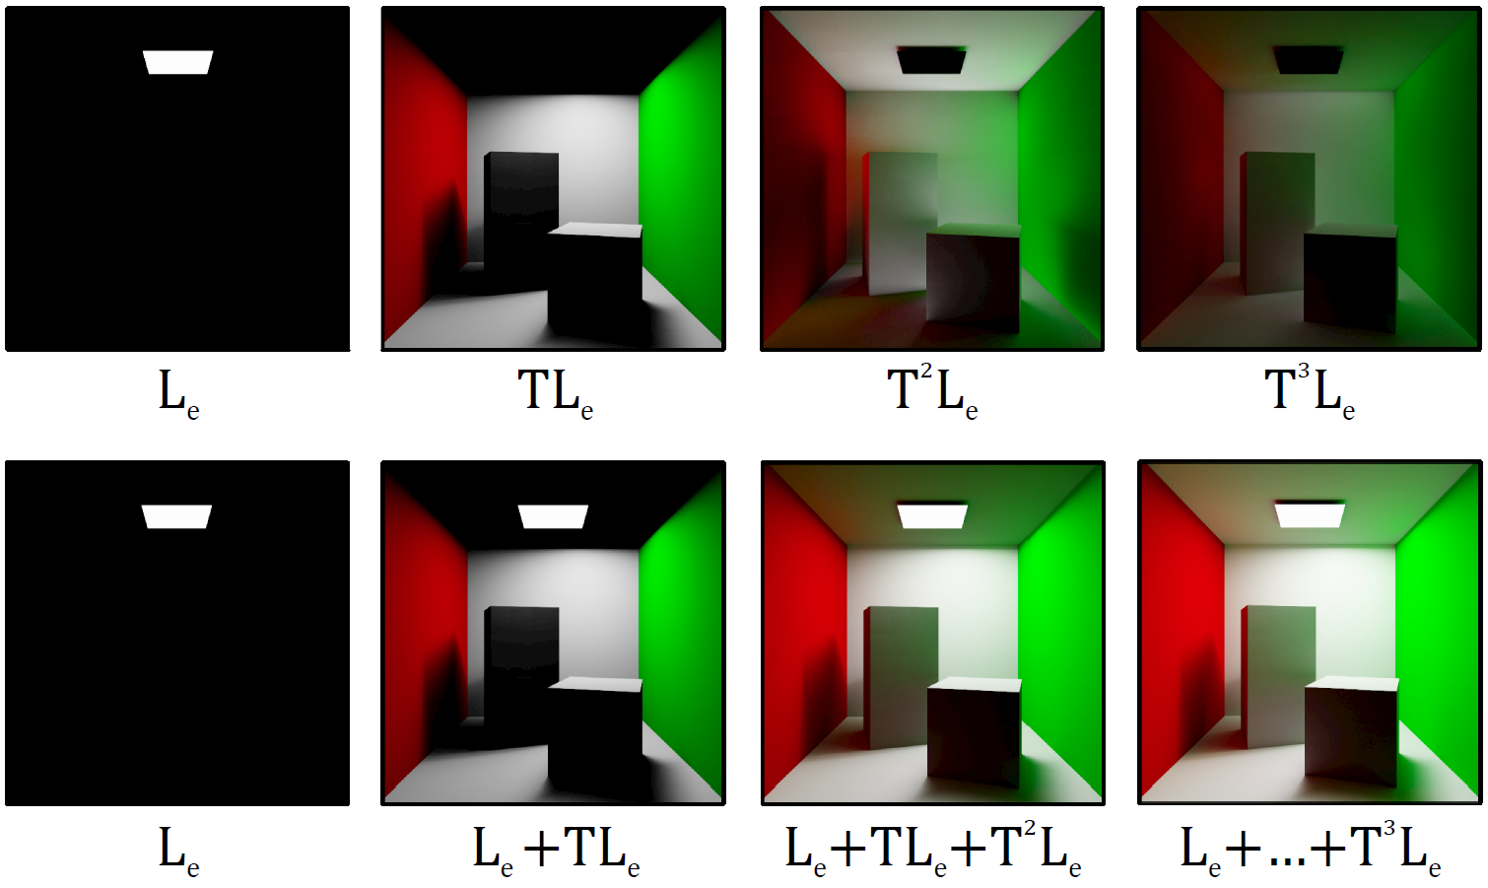
Introduction
The indirect lighting component is more computationally expensive

Slide 9
Irradiance Cache (IC)
Computes diffuse indirect lighting
Accelerates diffuse inter-reflection computations
view-independent
geometry-aware
Samples computed are cached in an acceleration structure
Interpolates through already cached samples to approximate a result
Interpolation depends on the α
More efficient than computing a new sample
Only possible since indirect lighting is a slow changing function
Notes:
Accelerated diffuse inter-reflections,
Diffuse interreflections is the computation of light that has already bounced multip;le number of timels before it reaches a diffuse surface
Diffuse surface is a surface thar reflects light evenly back into the scene eg the walls of this room ok?
Thus the cache computes such samples on demand whichare stored in a cache to be used for interpolation process
Basically since indirect lighting is a slow changing function we can use previosuly computed samples and interpolate between them to extrapolate a result
However unlike comput-ed samples inteprolated samples are not stored in the cache

Slide 10
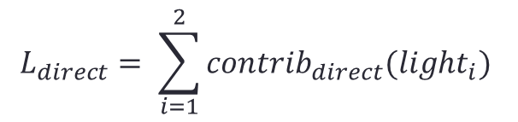
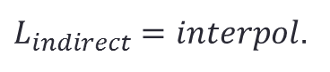
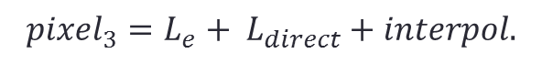
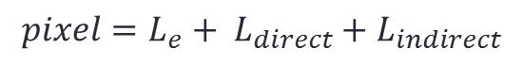
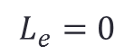
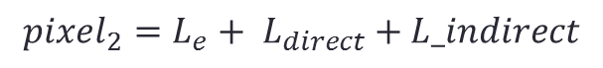
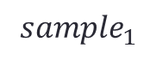
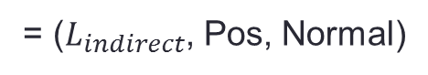
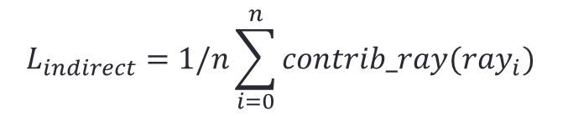
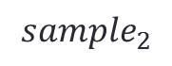
Irradiance Cache in Action
IC Cache
1
2
Indirect Lighting
Computation
Direct Lighting
Computation
$${sample}_{1}$$
= ($L_{indirect}$, Pos, Normal)
$${pixel_{2}=L_{e}+ L}_{direct}+L_indirect$$
$${sample}_{2}$$
$${pixel_{3}=L_{e}+ L}_{direct}+interpol.$$
$${pixel=L_{e}+ L}_{direct}+L_{indirect}$$
$$L_{direct}= \sum_{i=1}^{2}{contrib_{direct}(light_{i})}$$
$$L_{indirect}=1/n\sum_{i=0}^{n}{contrib_ray(ray_{i})}$$
$$L_{e}=0$$
$L_{indirect}=interpol$.
Notes:
Back to where you were =)

Slide 11
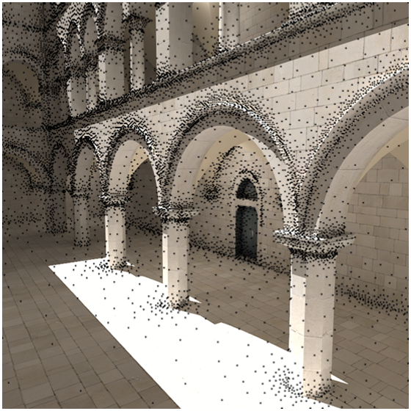
1
2
Geometry-aware sample generation

Slide 12
Parallelisation Techniques for the IC
Asymmetric Rendering
Debattista et al.
Symmetric Rendering
Koholka et al.
Different types of workers:
PR: Compute Direct lighting and indirect lighting interpolations
PA: Compute indirect lighting requests submitted by the previous group
PAs broadcast batches of samples between the group and the coordinator
PRs update their IC with new data upon syncing with coordinator
Broadcasting of samples between all peers involved
All PEs have the same task, executed on different data
Samples are not broadcasted as single entities:
Batched as groups of 50, to reduce the risk of high traffic over the network
However, both techniques improve performance for a single client
Notes:
Asymmetric distribution of work VS symmetric distribution of work

Slide 13
Collaborative Environments
In multi-user environments, peers interact in the same virtual environments (e.g. multiplayer games, simulations)
Users tend to carry out indirect lighting computations that may have already been effected by other participants in the same session.
Redundancy of light samples.
Notes:
Usually collaborative environments tend to make the users interact together in the same virtual enviorment
Each of which would carry out computations which might have already been carried out by other peers
We have redundant computations
13

Slide 14
Collaborative high-fidelity rendering over peer-to-peer networks
State of the art: high-fidelity rendering in collaborative environments
Unstructured, peer-to-peer system
Data propagation through epidemiological techniques, specifically - Anti-Entropy
Events are ordered via vector clocks
Make use of the irradiance cache (IC) as a case study
Peers exchange samples computed by the IC
Speed-up gained through the utilisation of received samples and not distribution of work
Notes:
What is the Anti-Entropy technique?
How do they share IC ocmputations?

Slide 15
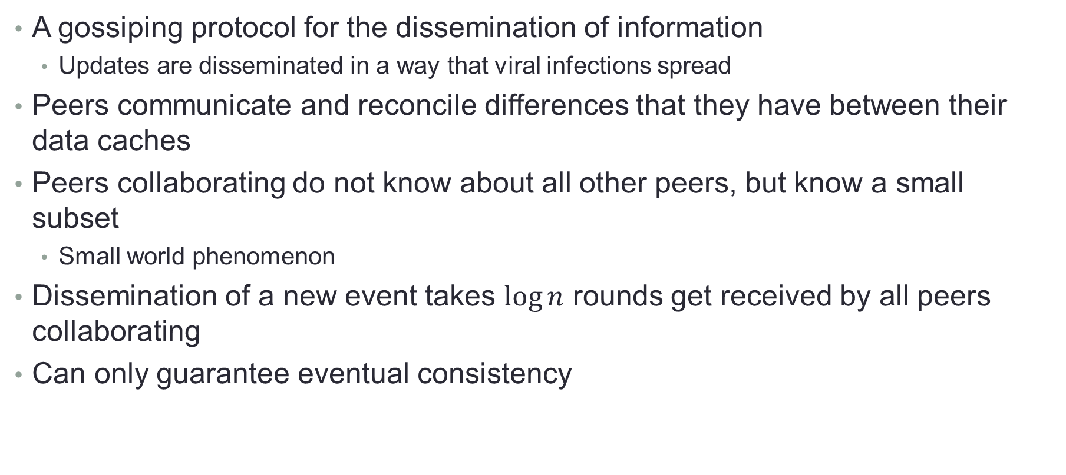
Anti-Entropy
A gossiping protocol for the dissemination of information
Updates are disseminated in a way that viral infections spread
Peers communicate and reconcile differences that they have between their data caches
Peers collaborating do not know about all other peers, but know a small subset
Small world phenomenon
Dissemination of a new event takes $\log{n}$ rounds get received by all peers collaborating
Can only guarantee eventual consistency
Notes:
Diagram

Slide 16
Oversaturation of the IC
Bugeja et al. ran tests on an 8 peer homogenous network
Hypothesised that as collaborations scale so does the amount of shared data
Caches become oversaturated
Oversaturation
Oversampling of the diffuse indirect function
Inefficient interpolations
No gain in visual accuracy
Computing a new sample takes less time than the interpolation process
Notes:
Nyquist theorem, indirect lighting is a slow changing function, more samples do not yield a better result
Therefore over-saturation is the point when an IC has more samples than it requires
Leading to a loss in the effiency gained from interpolation process

Slide 17
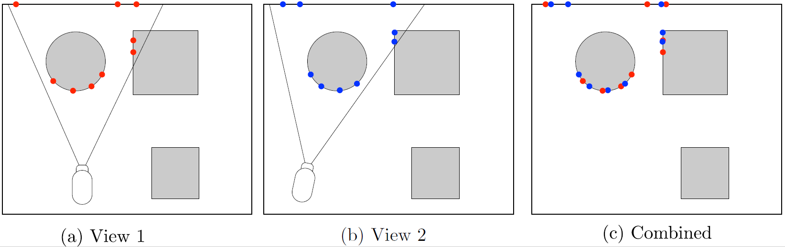
Oversaturation of the IC
Notes:
Eg, two peers rendering the same artefact in the same room
They did not manage to communicate in time to exchange computed samples thus, for an aretefact requiring n samples, we end up with 2n samples

Slide 18
Filtering Redundant Points
Redundant samples can be filtered in densely packed areas by applying a minimum distance constraint
Not applicable to sparsely packed regions of the cache
Notes:
Tightly packed areas of the scene can filter redundant samples through the use of the minimum distance constraint
However…..when samples are more sparsely packed, like presented in the floor of the rendered image, although the constraint is met, redundant samples cannot be Filtered out

Slide 19
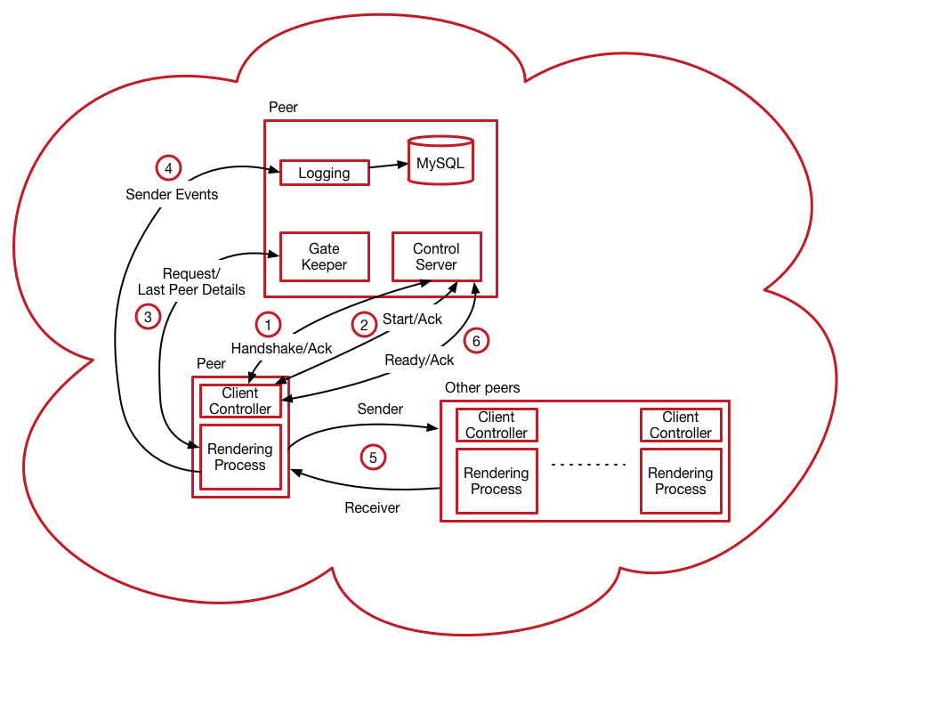
Experiment Framework
Entirely hosted on Azure
Composed of 17 homogenous VMs
1 VM dedicated for tests coordination
16 VMs dedicated for the collaboration
Notes:
Don’t refer to the gatekeeper as gatekeeper but as the bootstrapping mechanism

Slide 20
Benchmarks
Using the scenes used by the original authors
Tests scaled to 16 peer collaborations
4 different types of runs, as proposed by the original authors
Quiescent runs:
Identifying the maximum speed-up that is achievable through amortisation
Simultaneous:
All peers joining the collaboration at the same time
Delay of 400 and 800 seconds between entries
Entry of peers delayed by 400 and 800 to simulate specific online gaming scenarios (e.g. MMORPG)

Slide 21
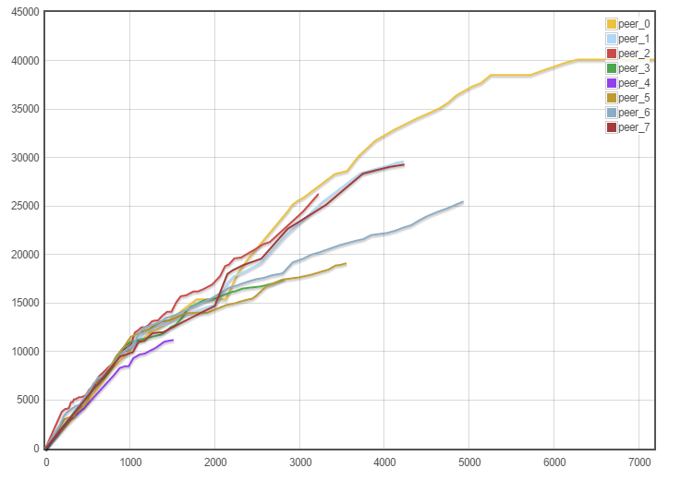
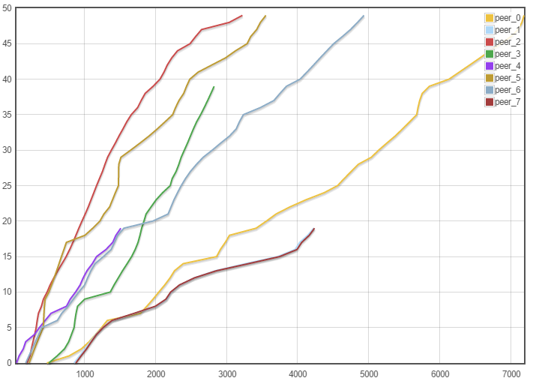
8 Peer Collaboration - Town
Number of received samples
Number of rendered frames
Time (s)
Time (s)
Cache size growth (left) and rendering time (right)
Notes:
Maximum 40000 samples contained in the
corraborated

Slide 22
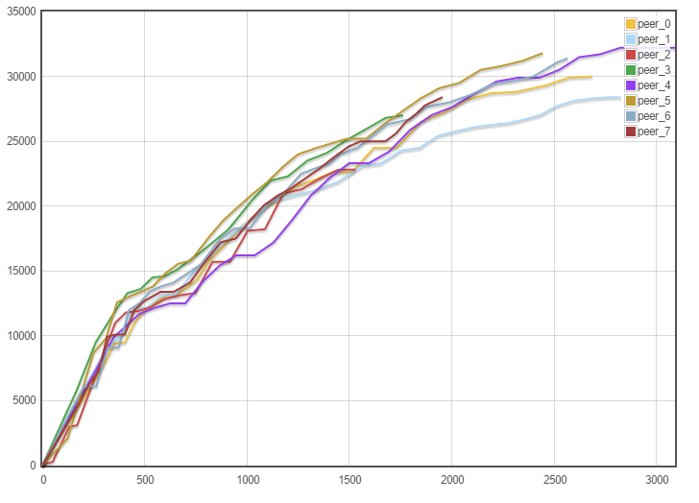
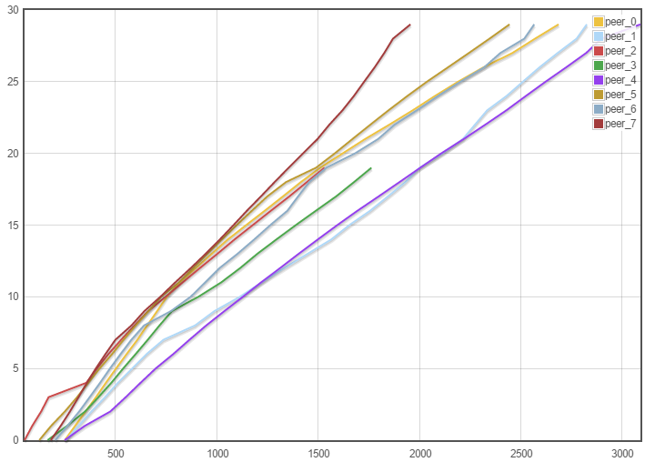
8 Peer Collaboration – Inner Sanctum
Number of received samples
Number of rendered frames
Time (s)
Time (s)
Cache size growth (left) and rendering time (right)

Slide 23
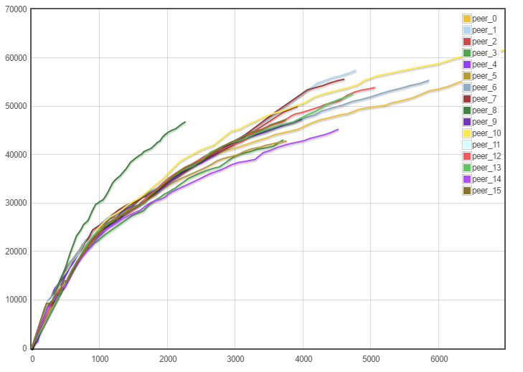
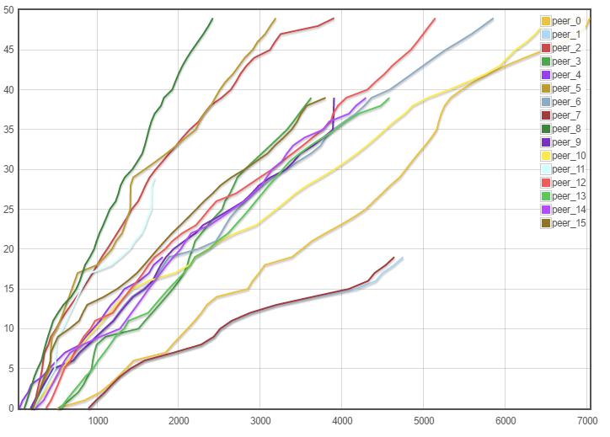
16 Peer Collaboration – Town
Number of received samples
Number of rendered frames
Time (s)
Time (s)
Cache size growth (left) and rendering time (right)

Slide 24
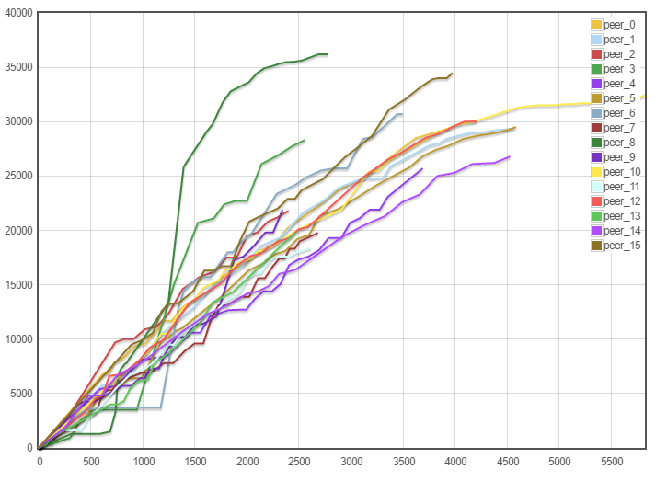
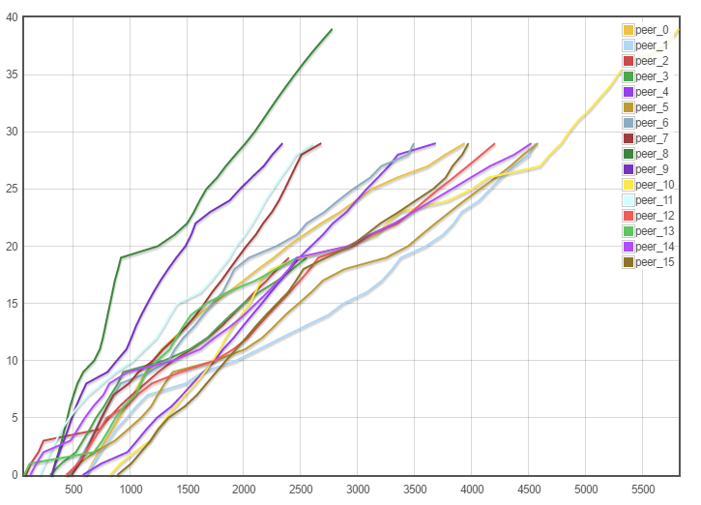
16 Peer Collaboration – Inner Sanctum
Number of received samples
Number of rendered frames
Time (s)
Time (s)
Cache size growth (left) and rendering time (right)

Slide 25
Two-Phase Irradiance Caching System (2PIC)
Divide the IC into two caches, to gain:
More efficient searches for the rendering process (Local)
Still able to contain all the received samples from the collaboration(Global)

Slide 26
Two-Phase Irradiance Caching System (2PIC)
Global Cache, contains all samples received through collaboration
Rendering
Process
R
R
Local cache, contains only samples required by the rendering process
Path No. | Path | Comment
1 | A, E | Local interp.
2 | A, B, D, E | Global interp.
3 | A, B, C, D, E | Sample scene
Action:
Local Interpolation
Global Interpolation
Sample scene and insert in both caches
Notes:
There are three ways for the interaction of the two caches

Slide 27
2PIC Evaluation
Quality of synthesised images
Rendering performance

Slide 28
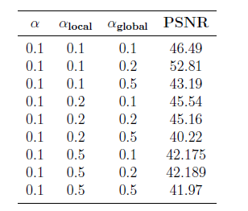
Quality
Aimed to asses the amount of error introduced by the technique
Synthesised renders by the IC and 2PIC were compared through the use of the peak signal-to-noise ration (PSNR) metric
PSNR is commonly employed as a measure of degradation between compressed and uncompressed images
All combinations of results contained values ranging between 40 and 55 dB
Notes:
Peak Signal to Noise Ratio

Slide 29
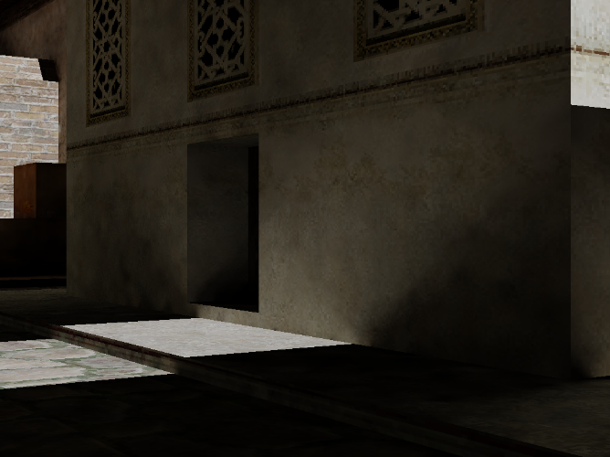
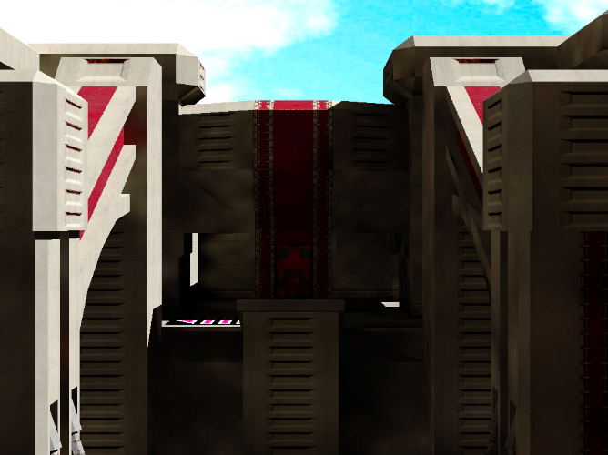
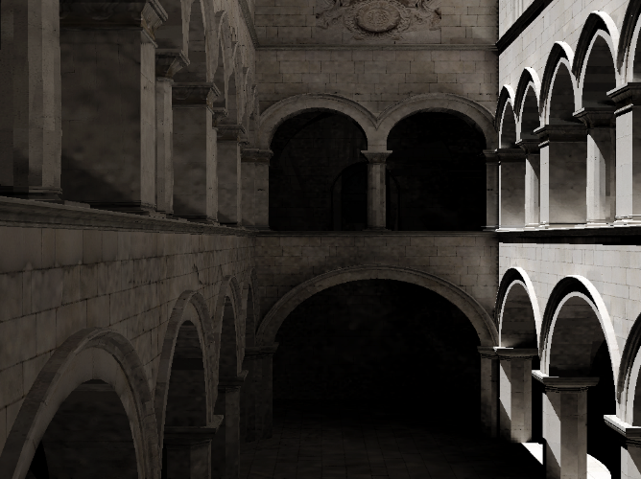
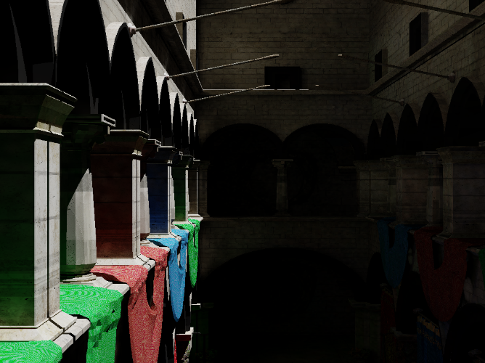
Quality Analysis Scenes

Slide 30

Traditional IC

Slide 31
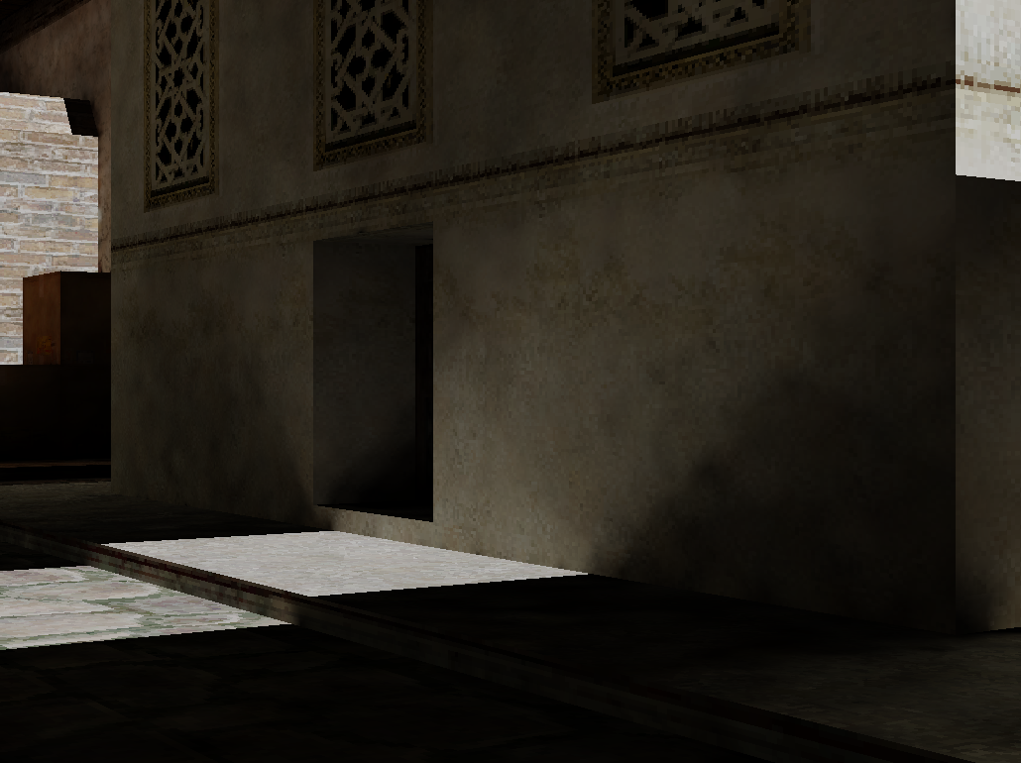
2PIC

Slide 32
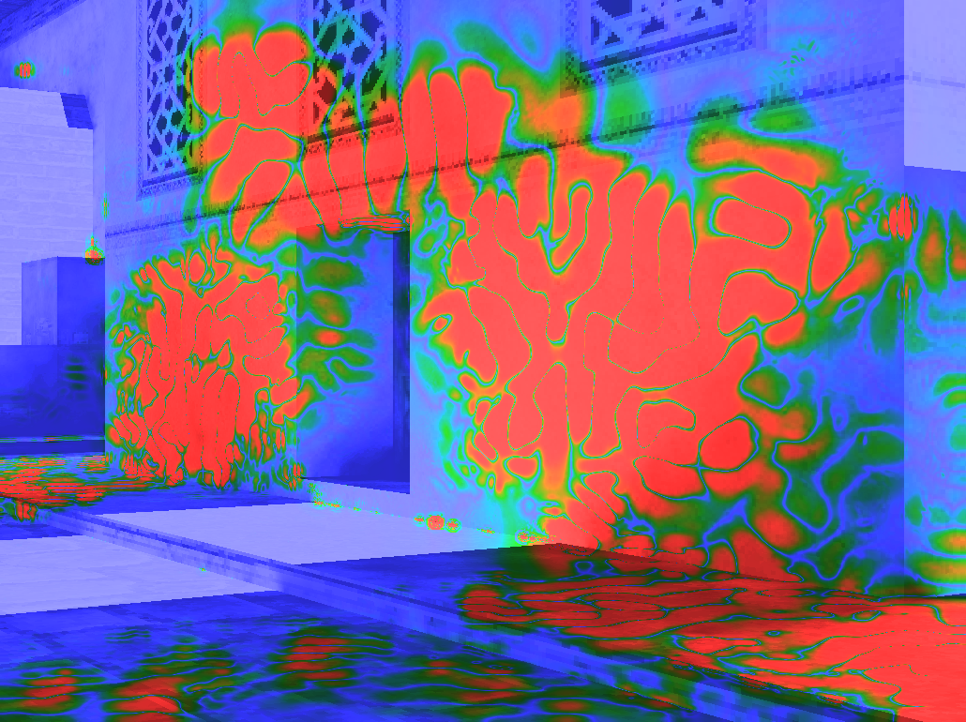
Perceptual Difference Between the Two Renders

Slide 33
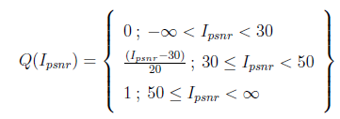
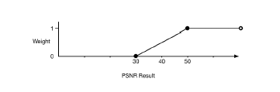
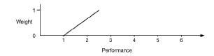
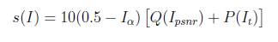
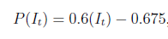
Rendering Performance
A set of α values was required for the global and local caches
Require a metric to find the optimal α values
Needs to take into consideration the PSNR and performance
Quality metric
Performance Combined

Slide 34
Rendering Performance
The most efficient set of α was found to be 0.5 for both caches
Experimental scenarios used to test the technique included:
Simultaneous: 8 and 16 peers
Staggered by 400 seconds: 8 and 16 peers
Staggered by 800 seconds: 8 and 16 peers
Recorded timings were compared to the timings of peers using the traditional technique

Slide 35
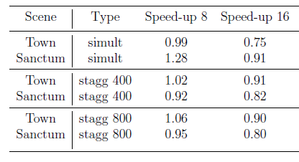
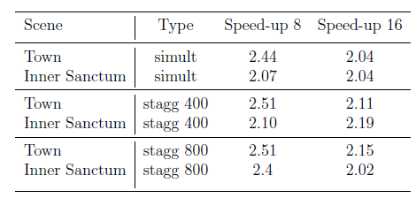
Rendering Performance Results
Traditional IC
2PIC
Notes:
Manage to gain an overall two fold improvement over all the scenarios that were used
The results hint that if we scale further the collaboration size we will reach a performance plateu

Slide 36
Looking at Eventual Consistency
Epidemiological techniques only guarantee eventual consistency
Guarantee samples are eventually received
Does not specify when samples are received
Scene lighting changes may not be received in time by the peers that most require them
Example: changes in room illumination should be propagated to peers found in same room first
Require a technique to disseminate data in order of importance
To focus data dissemination
Increase the frequency of updates
Retain properties of epidemiological systems

Slide 37
Improving Data Dissemination
Require a method to disseminate data in order of importance
Still requires to be decentralized and scalable
Improve data dissemination by communicating more frequently with peers that may provide gainful computations
Prioritising communication
Moving from a uniform distribution to a non-uniform one
Employ contexts
Contexts exploit attributes of peers to influence propagation and with the aim of improving update latency

Slide 38
Context = Importance
Use of contexts to prioritise message passing
Contexts allow peers to weigh communication with neighbors according to some importance
A context can be related to any variable that falls under the following classes:
Domain variables (e.g. observer position)
Infrastructure variables (e.g. network latency)

Slide 39
Context Aware Data Dissemination (CAP2P)
Use of the publisher/subscriber paradigm
Publisher disseminates information related to a specific context
An overlay of servers hosting specific contexts; referred to as microservers
Hosted by the peers collaborating, on demand
Each microserver hosts a particular context
A context represents a particular topic to which peers subscribe
Peers never subscribe to two microservers that host the same context
Use of a probability distribution function to prioritise (PDF) communication

Slide 40
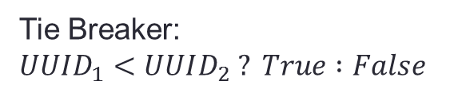
Overlay
n
Peer n
Anti-Entropy
Tie Breaker:
$UUID_{1}<UUID_{2} ? True :False$
n
Microserver hosting
context n
Subscription
1
2
3
4
5
6
7
8
9
A
A
A
B
B

Slide 41
Context Types
Four initial context types were chosen:
Observer Position
Bounding Boxes
Viewpoint
Latency
Domain attributes
Environment attribute

Slide 42
I. Observer Position Context
Peers send their current position to the microserver
Prioritization of peers according to the distance away from peer

Slide 43
II. Bounding Box Context
Preprocessing the scene to create a bounding box representation
Coarser grained version of the position context
Peers found in neighbouring bounding boxes are preferred over distant ones

Slide 44
III. View Point Context
Peers found in the vicinity might still not exchange useful computations
Peers are prioritized according to the intersection of viewing frusta

Slide 45
IV. Latency Context
Latency may be an indicator of traffic/hops between peers
Peers send the latency to a context server
Peers prioritise neighbours with lower latency

Slide 46
Prioritisation of Neighbours
Context updates determine peer importance in the neighbor cache
Only intersecting peers are updated
The overall weighting of a peer is modified with every update
Differential updates
PDF function updated accordingly

Slide 47
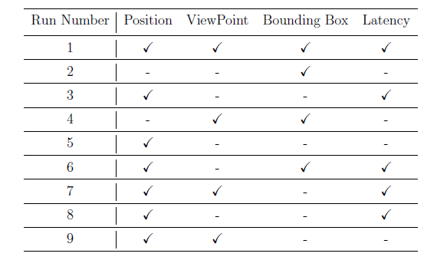
Evaluation
Tested different context combinations
Experiments: 16 simultaneous peers
Uses the two-level irradiance caching (2PIC)

Slide 48
Results
No performance penalties
Same two-fold improvement as context-less systems
Performance improvement rather shifted to specific peers
Results suggest that spatial contexts (position and bounding box contexts) were more effective
Position suggests that it provided timely updates
Bounding box prioritization not granular enough
Possibly excessive coverage
Combination of both balanced the benefits of position context

Slide 49
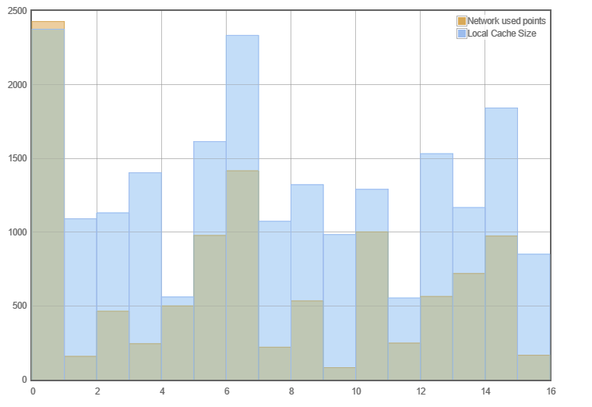
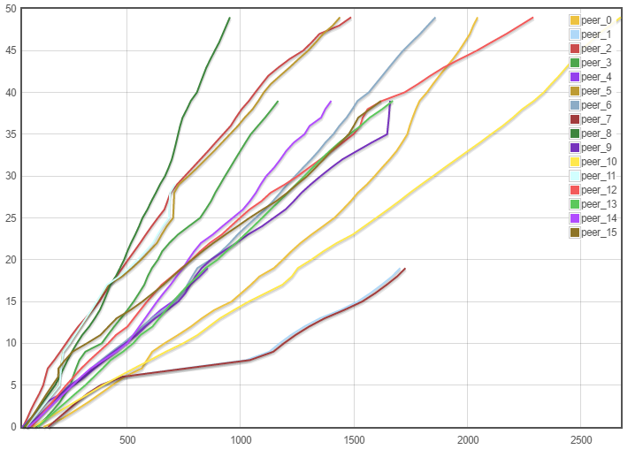
Context: Position
Rendered Frames
Local Samples and Used Network Sample
Peer number
Time (s)

Slide 50
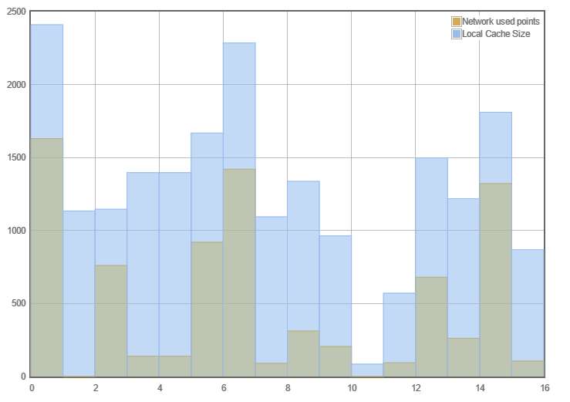
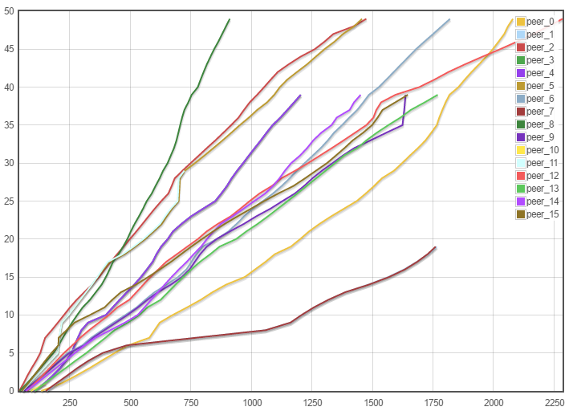
Context: Bounding Box
Rendered Frames
Local Samples and Used Network Sample
Peer number
Time (s)

Slide 51
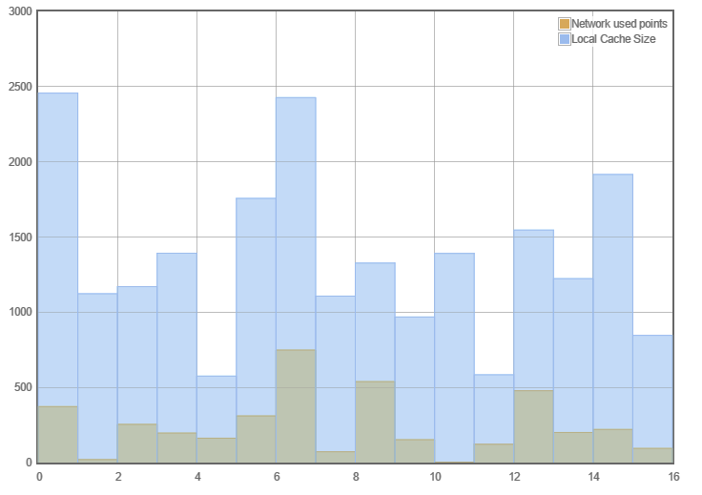
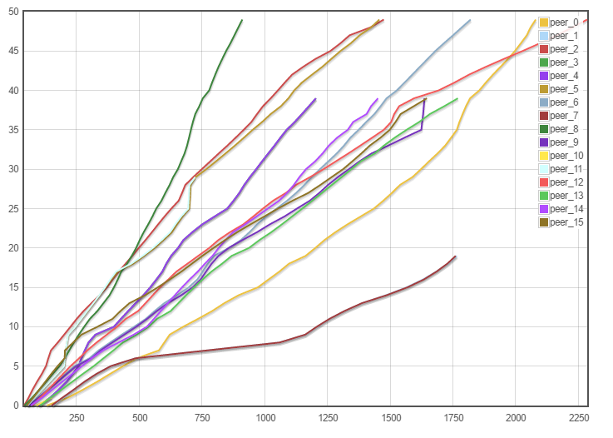
Context: Viewpoint
Rendered Frames
Local Samples and Used Network Sample
Peer number
Time (s)

Slide 52
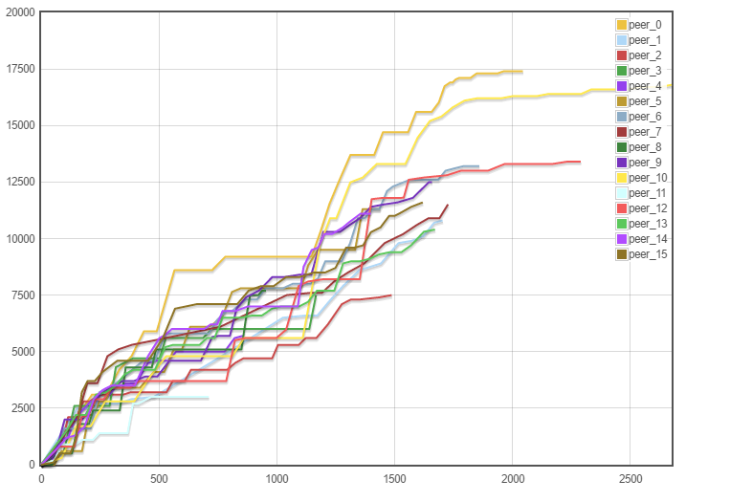

Global Caches Growth
Received Network Samples
Received Network Samples
Time (s)
Time (s)
Received network samples: Position (left) and Viewpoint (right)

Slide 53
Limitations
All contexts were given equal weighting
Microservers migrate subscribers despite no logical necessity
Established microserver loses tie breaker to a new microserver instance
Notes:
(Time constraints)

Slide 54
Future Work
2PIC
An improved metric for the analysis of 2PIC (incl. HDR-VDP2 metric)
A GPU-friendly implementation of 2PIC
Generalization of the 2PIC technique for scenarios prone to over-saturation of caches (not restricted to rendering techniques)
CAP2P
Further Analysis on the frequency of updates
Dynamic context weighting
Vector clock-based tie breakers
Notes:
HDR-VDP2 is another metric used to quantify the amount of difference between two images and takes into cosnsideration perception of the human eye

Slide 55
Corollary
An efficient rendering engine is a must for GI algorithms
A good test bench is a must for P2P systems
Azure and such cloud services are not a good option for running P2P experiments
Updates to the cloud platform may ruin the test bench (test bench was set 3 times)
Costly
Deployment and Peer management software is really important for carrying out tests that involve multiple computing units

Slide 56
Conclusion
2PIC mitigates over-saturation
Two-fold speed-up achieved for both 8 and 16 peers
Amortisation through collaboration provides two-fold speed-up and eliminates scalability bottlenecks of traditional single cache IC
A novel fully decentralized, anonymous publisher/subscriber overlay for improved data dissemination
Results suggest that the spatial contexts delivered computations that were required by the peers

Slide 57


Impact
Cinematography and animated movie industry
Shrek was wholly rendered using the Irradiance Cache
Improving rendering times
Collaborative simulations and visualizations
Gaming industry
Make diffuse GI viable for gaming (e.g. The Witness)
Application to scenarios where cache sharing is required to be efficient (e.g. Distributed DBs)

Slide 58
Thank You!

Slide 59
Benchmarks
Running collaboration tests required the following work:
Starting 17VMs on the cloud
VMs could not be left always on since that would incur extra fees
Preparation, boot up of PMS and logging system
Linking 16 VMs to the PMS system
Execute Test
Each test run could take to a maximum of 3.5 hours
Excluding runs that were deemed not fit for statistical analysis because of a crashing collaborator
Runs had to be repeated for experimental accuracy
160 hours (Phases 1 and 2)
Quality tests
7 different scenes were chosen
Each scene required a total of 18 different renders
Complex scenes required a total of 20 minutes to render a single image

Slide 60
Context Aware Data Dissemination
Publisher
Subscriber
Hosts a context
Accepts new subscribers
Received status updates from subscribers
Periodically update subscribers with the latest information
Is decommissioned once no more subscribers left
Subscribes to microservers
Periodically update publisher with latest information
Listen for updates from all publishers
Receives updates and computes PDF

Slide 61
Weighting Results
Single IC Alpha | Local IC Alpha | Global IC alpha | psnr | Performance | Weight PSNR | Weight performance | Overall Weight
0.1 | 0.5 | 0.5 | 41.97 | 4.6 | 0.5985 | 2.085 | 20.794
0.1 | 0.5 | 0.2 | 42.189 | 4.56 | 0.60945 | 2.061 | 20.6778
0.1 | 0.2 | 0.5 | 40.22 | 4.56 | 0.511 | 2.061 | 20.284
0.1 | 0.5 | 0.1 | 42.175 | 4.38 | 0.60875 | 1.953 | 19.955
0.1 | 0.1 | 0.5 | 43.19 | 3.45 | 0.6595 | 1.395 | 16.438
0.1 | 0.1 | 0.2 | 52.81 | 2.49 | 10 | 0.819 | 49.96
0.1 | 0.2 | 0.2 | 45.16 | 2.82 | 0.758 | 1.017 | 14.312
0.1 | 0.2 | 0.1 | 45.54 | 2.72 | 0.777 | 0.957 | 13.988
0.2 | 0.5 | 0.2 | 42.189 | 1.66 | 0.60945 | 0.321 | 6.80835
0.2 | 0.5 | 0.5 | 41.97 | 1.68 | 0.5985 | 0.333 | 6.8355
0.2 | 0.5 | 0.1 | 42.175 | 1.59 | 0.60875 | 0.279 | 6.59625
0.2 | 0.2 | 0.5 | 40.22 | 1.66 | 0.511 | 0.321 | 6.513
0.2 | 0.1 | 0.2 | 52.81 | 0.9 | 1 | -0.135 | 5.7
0.2 | 0.1 | 0.5 | 43.19 | 1.25 | 0.6595 | 0.075 | 5.7285
0.1 | 0.1 | 0.1 | 46.49 | 1 | 0.8245 | -0.075 | 7.298
0.2 | 0.2 | 0.2 | 45.16 | 1.03 | 0.758 | -0.057 | 5.364
0.2 | 0.2 | 0.1 | 45.54 | 0.98 | 0.777 | -0.087 | 5.271
0.5 | 0.1 | 0.2 | 52.81 | 0.54 | 10 | -0.351 | 0
0.5 | 0.5 | 0.2 | 42.189 | 1 | 0.60945 | -0.075 | 0
0.5 | 0.5 | 0.5 | 41.97 | 1.02 | 0.5985 | -0.063 | 0
0.5 | 0.5 | 0.1 | 42.175 | 0.96 | 0.60875 | -0.099 | 0
0.5 | 0.2 | 0.5 | 40.22 | 1.007 | 0.511 | -0.0708 | 0
0.5 | 0.1 | 0.5 | 43.19 | 0.76 | 0.6595 | -0.219 | 0
0.5 | 0.2 | 0.1 | 45.54 | 0.59 | 0.777 | -0.321 | 0
0.5 | 0.2 | 0.2 | 45.16 | 0.62 | 0.758 | -0.303 | 0
0.2 | 0.1 | 0.1 | 46.49 | 0.36 | 0.8245 | -0.459 | 3.5535
0.5 | 0.1 | 0.1 | 46.49 | 0.22 | 0.8245 | -0.543 | 0

